Slide 1
CS 5900/STAT 46700 Topics in Data Science
Data Science Ethics

Slide 2

Data Science
Data science is all about extracting insights from complex information with the use of programming and other techniques.
Data science is a multidisciplinary field of study that applies techniques and tools to draw meaningful information and actionable insights out of noisy data. Involving subjects like mathematics, statistics, computer science and artificial intelligence, data science is used across a variety of industries for smarter planning and decision making.

Slide 3
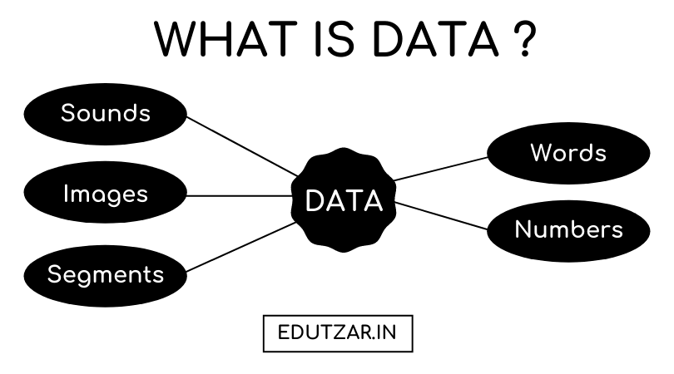
What is Data?
Data is defined as a collection of meaningful facts which can be stored and processed by computers or humans
Collection of unorganized facts, concepts, or instructions in a formalized manner suitable for communication, interpretation, processing by humans, or some automatic means such as computers.

Slide 4
What is Data?
Definition: Facts or figures, which are numerical or otherwise, collected with a definite purpose are called data.
Everyday we come across a lot of information in the form of facts, numerical figures, tables, graphs, etc.
These are provided by newspapers, televisions, magazines and other means of communication
These may relate to sports, politics, profits of a company, temperatures of cities, expenditures in various sectors of a five year plan, polling results, and so on

Slide 5
What can be done with Data?
Collect
Store
Manage
Retrieve
Analyze
Visualize
Mine
Learn
Model
Generate
Manipulate
Process
Clean
Transform
Filter
Search
Compress
Decompress
Structure
Randomize
Encode
Decode

Slide 6
Data Science Process in Summary
Capture
Maintain
Process
Analyze
Communicate

Slide 7
Data Science
An extensive discussion is currently in progress at different levels of society (including with academics, technicians, and public decision makers), revolving around ethical aspects related to the extensive usage of data and the application of automated processes and artificial intelligence (AI) methods.
https://pmc.ncbi.nlm.nih.gov/articles/PMC8672189/

Slide 8
Data Science
Data science involves the collection, analysis, and interpretation of large datasets to inform decision-making processes. As data science becomes increasing integrated into various fields like healthcare, criminal justices, it raises significant ethical concerns. Ethical Data science ensures that data is used in a responsible and a transparent manner with the rights and well-being of individuals and communities.

Slide 9
What Is Data Science Ethics?
Ethics in Data Science refers to the responsible and ethical use of the data throughout the entire data lifecycle. This includes the collection, storage, processing, analysis, and interpretation of various data.
Privacy: It means respecting an individual's data with confidentiality and consent. Personally Identifiable Information(PII) must be confidential.
Transparency: Communicating how data is collected, processed, and used, So it will maintain transparency.
Bias: Ensuring fairness in data-driven processes and addressing biases that may arise in algorithms, preventing discrimination against certain groups.
Accountability: Holding individuals and organizations accountable for their actions and decisions based on data.
Security: Implementing robust security measures sensitive data and protects them from unauthorized access and breaches.
Data Quality: Ensures the accuracy of the data , completeness and the reliability of the data to prevent any misinformation.

Slide 10
The Importance of Ethical Data Usage
Data Scientist are the Heart of Data they hold the data which can make powerful decisions that can shape the future. the data is more valuable than anything so maintaining ethical standards is not a obligation but it's a fundamental aspect of a Data scientist ensuring responsible data usage
Ethical Data usage is the main block of trust. When individuals provide their Data to organizations or platforms, they expect it to maintain with integrity and basic ethics. Respecting their privacy is most important part as it will increase the organization reputation

Slide 11
Key Practices for Responsible Data Usage
Transparency and Documentation
Transparent documentation serves as the backbone of ethical decision-making in data science. It involves:
Data Sources: Clearly outlining where the data originates from, including its collection methods and any third-party sources involved.
Methodologies: Describing the techniques, algorithms, and processes used for data analysis and model creation. This transparency aids in understanding how conclusions are drawn.
Transformations: Documenting any modifications or preprocessing steps applied to the data before analysis. It ensures reproducibility and validates the accuracy of results.

Slide 12
Key Practices for Responsible Data Usage
Bias Mitigation
Identifying and mitigating biases in data and algorithms is critical for fair outcomes. This includes:
Data Audits: Regularly auditing datasets for inherent biases based on demographics or historical imbalances.
Algorithm Fairness: Assessing algorithms to detect and rectify biases in decision-making processes to ensure fairness across diverse groups.
Diverse Representation: Actively seeking diverse perspectives and inclusivity in datasets and model development to avoid reinforcing existing biases

Slide 13
Key Practices for Responsible Data Usage
Data Privacy and Consent
Respecting data privacy laws and obtaining informed consent are foundational principles:
Informed Consent: Clearly communicating to individuals how their data will be used, ensuring they understand and agree to its usage.
Anonymization: Stripping personally identifiable information whenever possible to protect individual identities.
Compliance: Adhering to legal frameworks such as General Data Protection Regulation (GDPR), Health Insurance Portability and Accountability Act (HIPAA), or California Consumer Privacy Act (CCPA) to ensure lawful and ethical data handling.

Slide 14
Key Practices for Responsible Data Usage
Security Measures
Safeguarding data against breaches or unauthorized access involves robust security protocols:
Encryption: Protecting data through encryption methods to ensure confidentiality, especially for sensitive information.
Access Control: Implementing strict access controls to limit data access to authorized personnel only.
Regular Audits: Conducting periodic security audits and assessments to identify vulnerabilities and rectify them promptly.

Slide 15
Key Practices for Responsible Data Usage
Ethical Decision-making
Considering the broader ethical implications of data usage and model outcomes involves:
Societal Impact Assessment: Evaluating the potential societal consequences of deploying models or algorithms on different groups or communities.
Ethical Frameworks: Using established ethical frameworks to guide decision-making and identify potential ethical dilemmas.
Continuous Evaluation: Regularly assessing the ethical implications of data usage and model outcomes throughout the project lifecycle.

Slide 16
Key Practices for Responsible Data Usage
Transparency and Accountability
Transparency means being open and telling everyone about what's happening and letting everyone know how the data is being used. it's like an open window
When it comes to Data Science, data is the most valuable thing so, maintaining the transparency in how the data is being used that means telling where the data comes from and how it's being used
on the other hand accountability means nothing but responsibility that means taking the responsibility for how the data is handled
Together, transparency and accountability create trust and reliability. Transparency builds understanding, allowing others to see the 'why' and 'how' behind actions.
Accountability ensures that those responsible for managing data are answerable for their actions and decisions, fostering a sense of responsibility and trustworthiness in data practices.

Slide 17
Promoting Responsible Data Science
Responsible data science means using data in a good and fair way and the Data Scientist must stick to the ethics that means he should use the data only for finding the answers to the question to solve the problems Here's how we can do it in a simple way that's easy to understand
Being Honest
Being Fair to Everyone
Keeping Secrets Safe
Protecting Data like a Treasure
Thinking Before Making Big Choice

Slide 18
Principles within Data Ethics
Seek to enhance the value of data science for society
Avoid harm
Apply and maintain professional competence
Seek to preserve or increase trustworthiness
Maintain accountability and oversight
https://rss.org.uk/RSS/media/News-and-publications/Publications/Reports%20and%20guides/A-Guide-for-Ethical-Data-Science-Final-Oct-2019.pdf

Slide 19
References
Ethical Practice of Statistics and Data Science by Rochelle E. Tractenberg
Ethical Guidelines for Statistical Practice (ASA) https://www.amstat.org/your-career/ethical-guidelines-for-statistical-practice
https://rss.org.uk/RSS/media/News-and-publications/Publications/Reports%20and%20guides/A-Guide-for-Ethical-Data-Science-Final-Oct-2019.pdf
https://www.geeksforgeeks.org/ethics-in-data-science-and-proper-privacy-and-usage-of-data/

